Slide 1
Predicate Logic Resolution-Exercise 2.2
By: Császár Mózes

Slide 2

Problem Statement
Are the literals from the following pairs unifiable? If yes, find their most general unifier. x, y, z$∈$Var, a, b$∈$Const, f, g $∈$ F₁, h $∈$ F₂, P $∈$ P₃.
P(a, x, f(g(y))) and P(y, f(z), f(z));
P(x, g(f(a)), f(b)) and P(f(y), z, z);
P(a, x, f(g(y))) and l₂=P(z, h(z, u), f(b)).

Slide 3
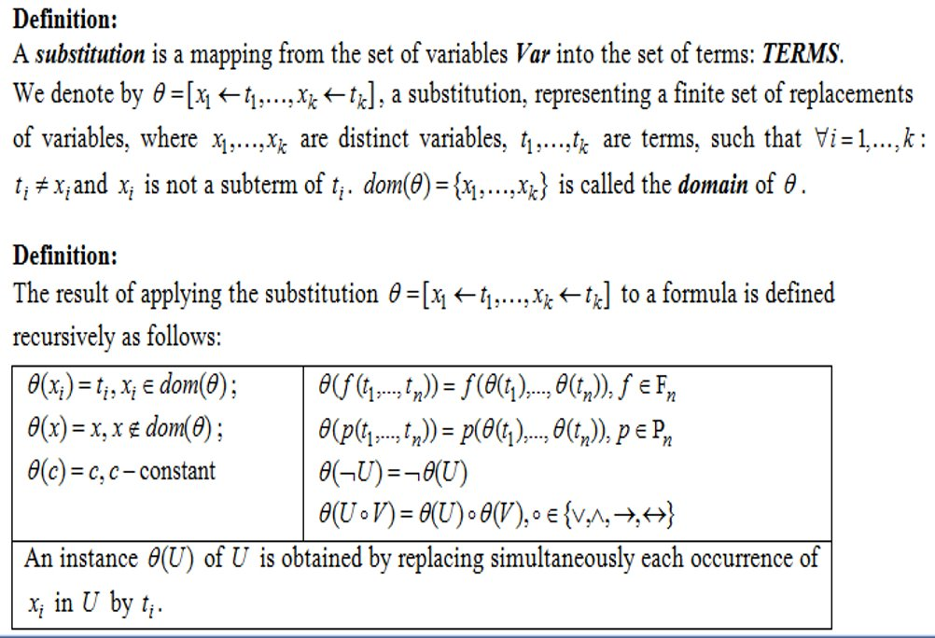
Theory-Substitutions

Slide 4
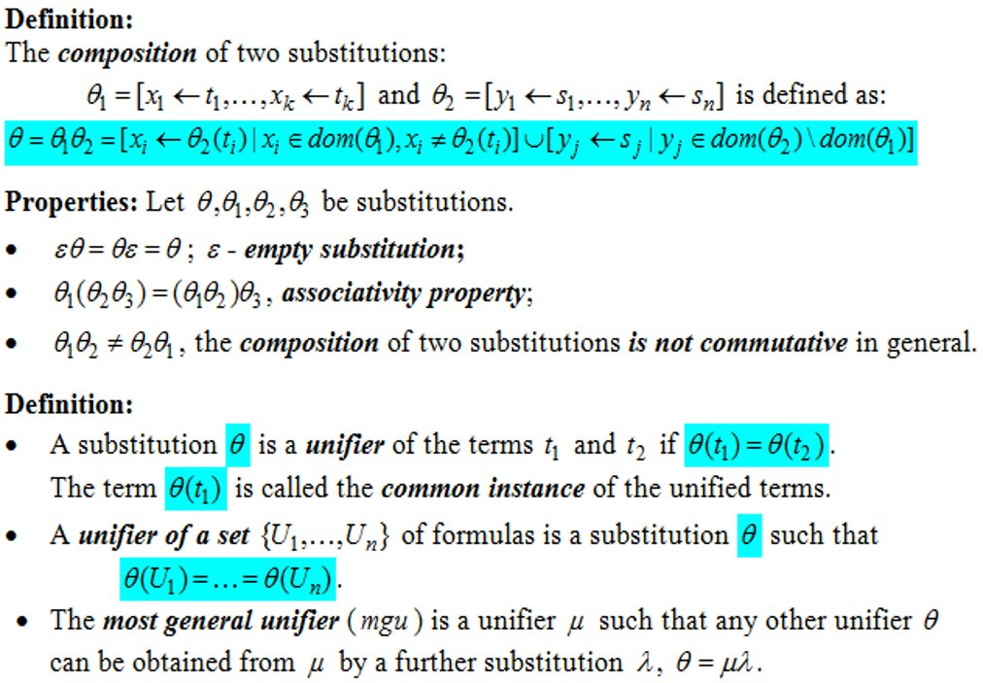
Theory-Composition of Substitutions, Unifiers

Slide 5
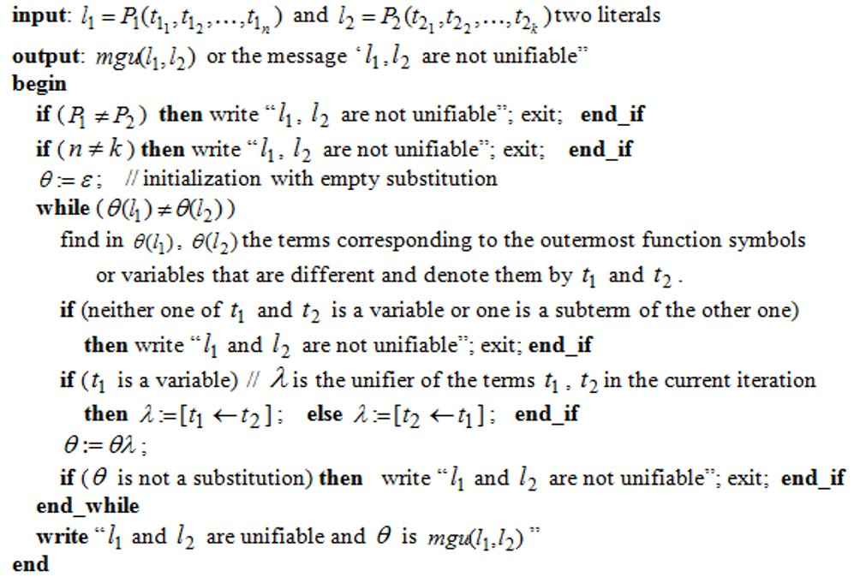
Theory- Computation of the Most General Unifier of Two Literals

Slide 6
l₁=P(a, x, f(g(y))) l₂=P(y, f(z), f(z))
Θ := ε
λ = [y ← a]
Θ := Θ λ = [y ← a]
Θ(l₁) = P(a, x, f(g(a))) Θ(l₂) = P(a, f(z), f(z))
λ = [x ← f(z)]
Θ := Θ λ = [y ← a , x← f(z) ]
Θ(l₁) = P(a, f(z), f(g(a))) Θ(l₂) = P(a, f(z), f(z))
λ = [z ← g(a)]
Θ := Θ λ = [y ← a , f(z) ← x, z← g(a)]
Θ(l₁) = P(a, f(g(a)), f(g(a))) Θ(l₂) = P(a, f(g(a)), f(g(a)))
Θ(l₁) = Θ(l₂) => the literals from the two formulas are unifiable, the most general unifier being Θ = [y ← a , f(z) ← x, z← g(a)]

Slide 7
l₁=P(x, g(f(a)), f(b)) l₂=P(f(y), z, z)
Θ := ε
λ = [x ← f(y)]
Θ := Θ λ = [x ← f(y)]
Θ(l₁) = P(f(y), g(f(a)), f(b)) Θ(l₂) = P(f(y), z, z)
λ = [z ← g(f(a))]
Θ := Θ λ = [x← f(y), z ← g(f(a))]
Θ(l₁) = P(f(y), g(f(a)), f(b)) Θ(l₂) = P(f(y), g(f(a)), g(f(a)))
λ = ε, because we cannot exchange two constants, Θ(l₁) = Θ(l₂) doesn’t hold => the literals from the formulas l₁ and l₂ are not unifiable.

Slide 8
l₁=P(a, x, f(g(y))) l₂=P(z, h(z, u), f(b))
Θ := ε
λ = [z ← a]
Θ := Θ λ = [z ← a]
Θ(l₁) = P(a, x, f(g(y))) Θ(l₂) = P(a, h(a, u), f(b))
λ = [x← h(a, u)]
Θ := Θ λ = [z ← a, x← h(a, u)]
Θ(l₁) = P(a, h(a, u), f(g(y))) Θ(l₂) = P(a, h(a, u), f(b))
Because g(y) cannot always be unified with b=> the literals from the two formulas are not unifiable.

